Slide 1
Differential WBC count

Slide 2
Principle
A blood film is stained with Leishman’s stain and scanned under oil immersion, from one end to the other.
2. Determines the number of each type of white blood cell, present in the blood.
3. It can expressed as a percentage (relative numbers of each type of WBC in relationship to the total WBC).

Slide 3
Leukocytes
Leukocytes are divided into two groups according to the type of cytoplasmic granules and the shape of their nuclei:
Granulocytes
Agranulocytes

Slide 5
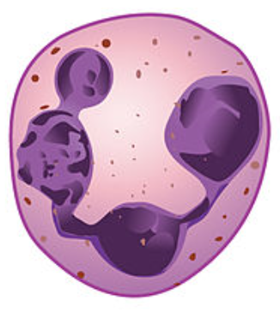
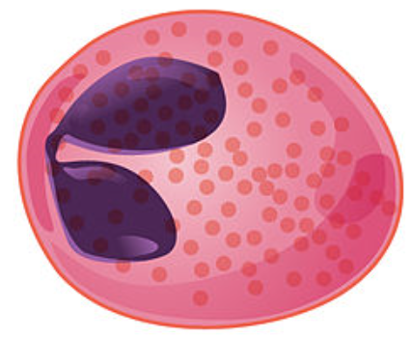
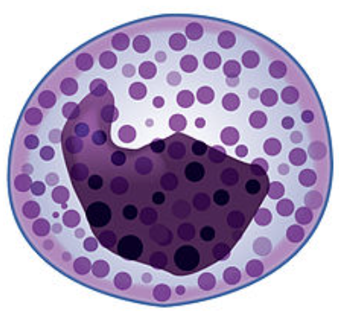
Granular leukocytes
Neutrophil | Eosinophil | Basophil
40–70% of circulating WBCs | 1–6% of circulating WBCs | <1% of circulating WBCs
Cytoplasmic granules are fine & stained violet pink | Cytoplasmic granules are coarse & stained red | Cytoplasmic granules are coarse & stained dark blue
Nucleus with 3-5 lobes | Bi-lobed nucleus | S-shaped nucleus

Slide 6
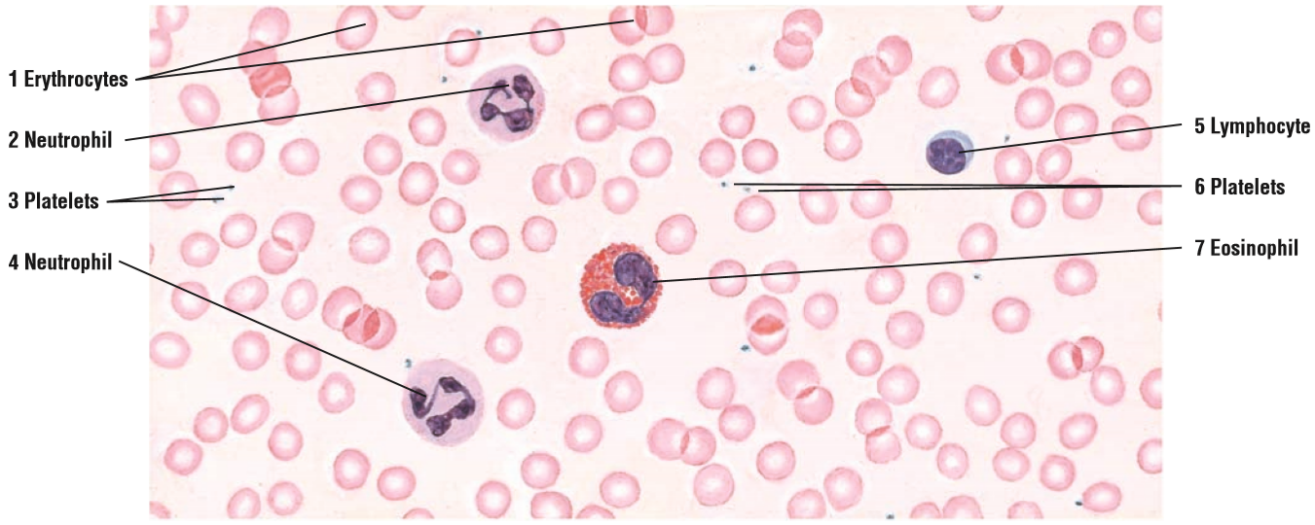

Slide 7
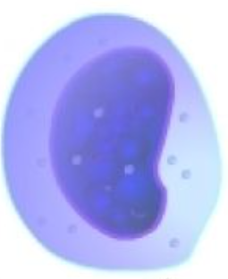
Agranular leukocytes
Lymphocytes | Monocytes
20–40% of circulating WBCs | 5–10% of circulating WBCs
Spherical cell, thin crescent of clear, light blue cytoplasm | Large spherical cells, abundant cytoplasm stains gray-blue
Large, round nucleus, almost fills cell | Large U-shaped or kidney shaped nucleus

Slide 8
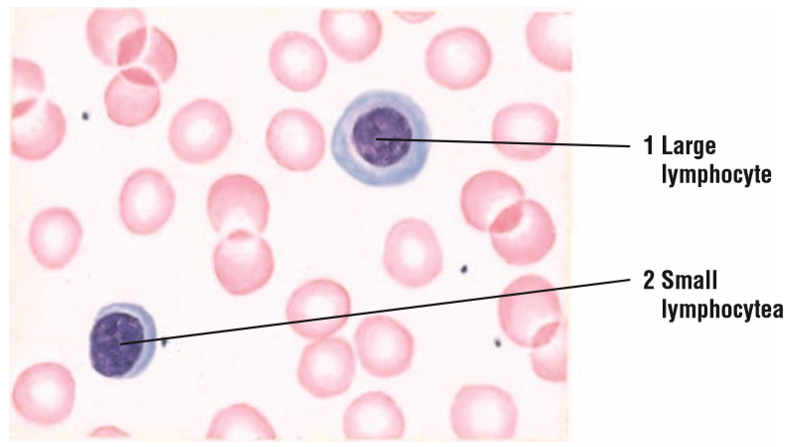

Slide 9
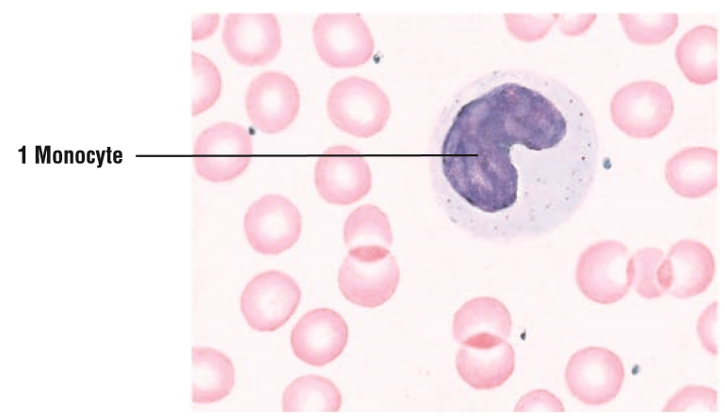

Slide 10
Apparatus and materials
Microscope
Clean glass slides, sterile lancet, cotton , and 70% alcohol
A drop bottle containing Leishman’s stain
A wash bottle of distilled water
Giemsa stain or Leishmans stain.

Slide 11
Apparatus and materials
Leishman’s stain
It contains a compound dye ’’eosinate of methylene-blue’’ dissolved in acetone-free methyl alcohol.
Eosin; It is an acidic dye and stains basic granules in the cytoplasm a red color (eosinophil).
Methylene-blue; It is a basic dye and stains acidic granules in the cytoplasm a blue-violet. Color (basophil).

Slide 12
Blood smear
blood smear is one of the most frequently requested tests in the hematology laboratory.
Blood smear must be prepared correctly and examined in such a way as to provide the physician with an accurate interpretation.

Slide 13
Preparing the blood films
Place 2 slides on a white sheet of paper on your work-table.
Place a drop of blood from the finger about 2 mm in diameter in the central line of a slide about 1-2 cm from one end.
The spreader is placed at angle of 45 degrees to the slide and then moved back to make contact with the drop.
The drop should spread out quickly along the line of contact of the spreader with the slide.

Slide 14
Preparing the blood films
The drop should be of such size that the film is 3-4 cm in length.
The film should be dried rapidly. A good blood film preparation will be thick at the drop end and thin film at the opposite end.
The thickness of the spread when pulling the smear is determined by the:
a. Angle of the spreader slide.
b. Size of the blood drop.
c. Speed of spreading.

Slide 15
Preparing the blood films

Slide 16
Preparing the blood films

Slide 17
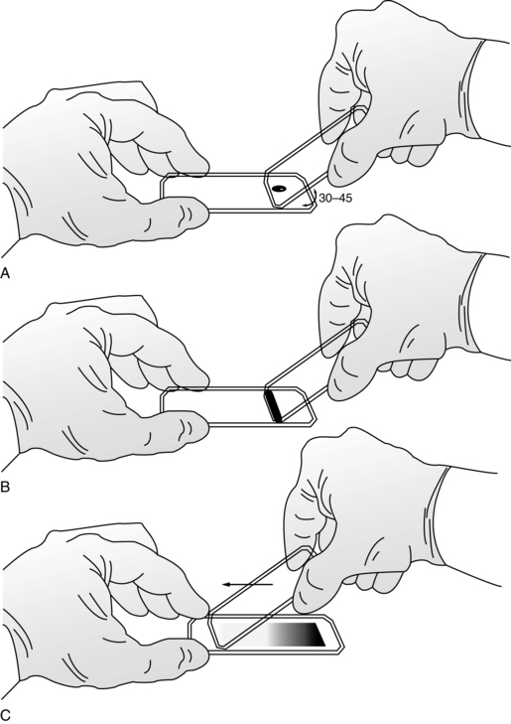

Slide 18
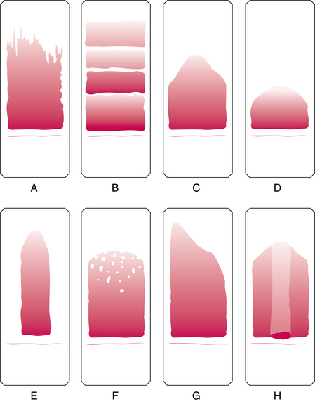

Slide 19
Fixing & Staining of blood films
Fixation: Before staining, the blood films need to be fixed with acetone free methyl alcohol for 0.5 to 2 minutes in order to prevent hemolysis when they come in contact with water when water has to be added subsequently. Alcohol denature the proteins and hardness the cell contents.

Slide 20
Fixing & Staining of blood films
Staining: is the process that stains (colors) the nuclei and cytoplasm of the cells.
Leishmans stain
Method of staining
Pour few drops (about 8) on the slide, Wait for two minutes.
Add double the amount (16 drops) of buffered water. Mix by rocking and wait for 7-10 minutes.
The stain is flooded off with distilled water and this should be complete in 2-3 second, and allow it to dry.

Slide 22
Fixing & Staining of blood films
Giemsa stain
This makes stock solution and before use it has to be diluted by adding 1 ml (stain) to 9 ml buffered water.
Method of staining
The blood is fixed with methyl alcohol for 2 minutes.
Pour Giemsa stain diluted 1:9 with buffer over the smear for 8-10 minutes.
Wash off with buffer and dry.

Slide 23
Fixing & Staining of blood films

Slide 24
Examination of a blood film
There are several necessary step in the examination of a peripheral blood smear:
1. Under the low- power (10X), determine the overall staining quality of the blood smear.
2. Determine if there is a good distribution of cells on the smear.
3. Find an optimal area for the detailed examination and enumeration of cells.
Notes:
Presence of stain granules. Occasionally, round, solid-looking, deep blue-violet particles of stain get precipitated all over a blood film. They appear if the Leishman’s stain is old, or if it has not been properly filtered, or if it was allowed to dry up on the slide during fixing. Finally, it may be due to insufficient washing of the greenish metallic scum that forms on the stain-water mixture during staining.
2. Excessively blue appearance. The RBCs appear deep blue or even bluish-black. The nuclei of WBCs are stained dark blue, with bluish cytoplasm in all cells; the PMNs cannot be differentiated. This appearance may be due to over-staining, over- fixing, insufficient washing or the use of alkaline stain or water. It can be corrected by reducing the fixing and staining times, and proper washing under running water.
3. Excessively reddish appearance. In this case the red cells appear pale pink. The WBCs show pale blue cytoplasm, while the nuclei typically appear lighter than the cytoplasm, or even colorless. This appearance may be due to understaining, over- washing or the use of more acidic stain or water. The defect may be rectified by re-staining, if required.
4. Faded appearance of blood cells. This may result from the use of old stain, under-staining, or over-washing.

Slide 25
Staining defects
The staining defects include:
Precipitation of stain particles
Over staining
Under staining
Notes:
Presence of stain granules. Occasionally, round, solid-looking, deep blue-violet particles of stain get precipitated all over a blood film. They appear if the Leishman’s stain is old, or if it has not been properly filtered, or if it was allowed to dry up on the slide during fixing. Finally, it may be due to insufficient washing of the greenish metallic scum that forms on the stain-water mixture during staining.
2. Excessively blue appearance. The RBCs appear deep blue or even bluish-black. The nuclei of WBCs are stained dark blue, with bluish cytoplasm in all cells; the PMNs cannot be differentiated. This appearance may be due to over-staining, over- fixing, insufficient washing or the use of alkaline stain or water. It can be corrected by reducing the fixing and staining times, and proper washing under running water.
3. Excessively reddish appearance. In this case the red cells appear pale pink. The WBCs show pale blue cytoplasm, while the nuclei typically appear lighter than the cytoplasm, or even colorless. This appearance may be due to understaining, over- washing or the use of more acidic stain or water. The defect may be rectified by re-staining, if required.
4. Faded appearance of blood cells. This may result from the use of old stain, under-staining, or over-washing.

Slide 26
Observations and results
The dry and stained film is examined without a coverslip under oil immersion objective.
For differential leucocyte counts choose an area where the morphology of the cells is clearly visible.
Do differential count by moving the slide in area including the central and peripheral of the smear.
A total of 100 cells should be counted in which every white cell seen must be recorded in a table under the following heading: Neutrophil, Basophil, Eosinophil, Monocyte and Lymphocyte.
Then find the percentage of each type.

Slide 27
Differential counting of leukocyte
Normal Results
Neutrophils: 40% to 60%
Lymphocytes: 20% to 40%
Monocyte: 2% to 8%
Eosinophils: 1% to 4%
Basophils: 0.5 to 1%
Band (young neutrophil): 0% to 3%

Slide 28
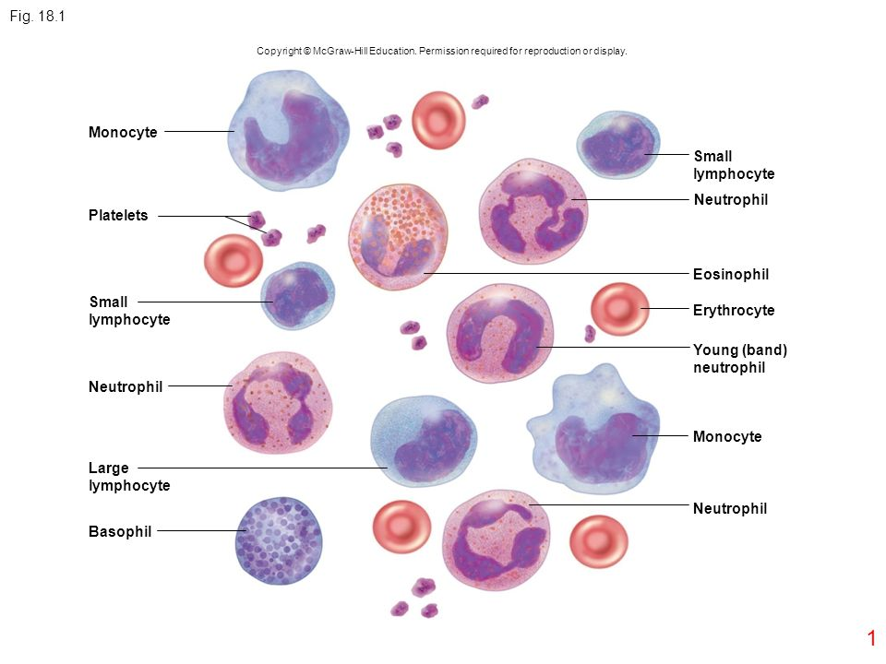

Slide 29
What abnormal results Mean
• Any infection or acute stress increases your number of white blood cells.
• High white blood cell counts may be due to inflammation, an immune response, or blood diseases such as leukemia.
• It is important to realize that an abnormal increase in one type of white blood cell can cause a decrease in the percentage of other types of white blood cell.

